Slide 1
Deep Learning Models (CNN and ResNet)
By: Steven Cao

Slide 2
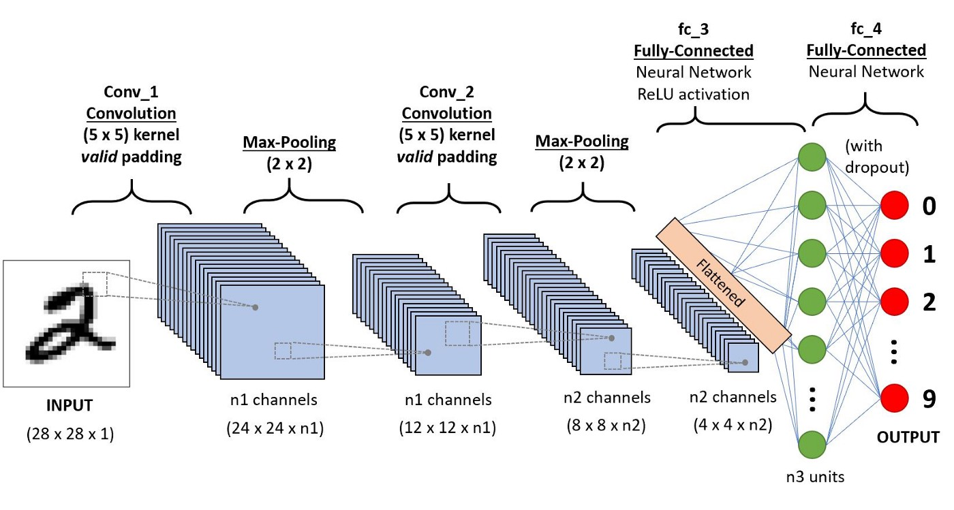
Convolutional Neural Networks (CNN) (1)
What are Convolutional Neural Networks?
A Deep Learning algorithm which can…
Take in an input image,
Assign importance (learnable weights and biases) to various features in the image
Differentiate one class from the other classes

Slide 3
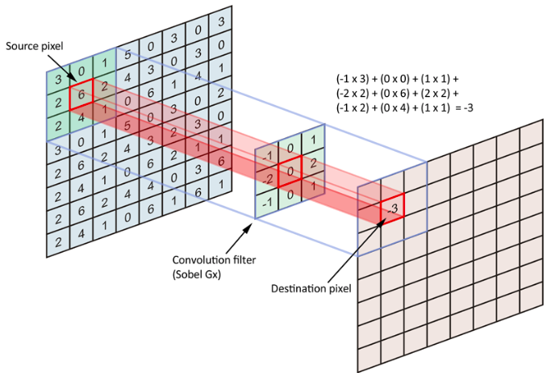
“Convolution” part of Convolutional Neural Networks
The term convolution refers to the mathematical combination of two functions to produce a third function.
It merges two sets of information.
The convolution is performed on the input data with the use of a kernel to then produce a feature map.
These feature maps are input extracted features.

Slide 4
Advantages of Convolutional Neural Networks
Detects the important features without any human supervision.
Does the feature extraction process for you.
For example, given many pictures of cats and dogs it learns distinctive features for each class by itself.
Flexible and work well on image data
Can handle large, unstructured data

Slide 5
Disadvantages of Convolutional Neural Networks
Requires a large dataset to process and train the neural network.
Takes a very long time to train a convolutional neural network, especially with large datasets.
Especially if you do not use a GPU.
Generally bad at handling rotation and scale-invariance without explicit data augmentation.

Slide 6
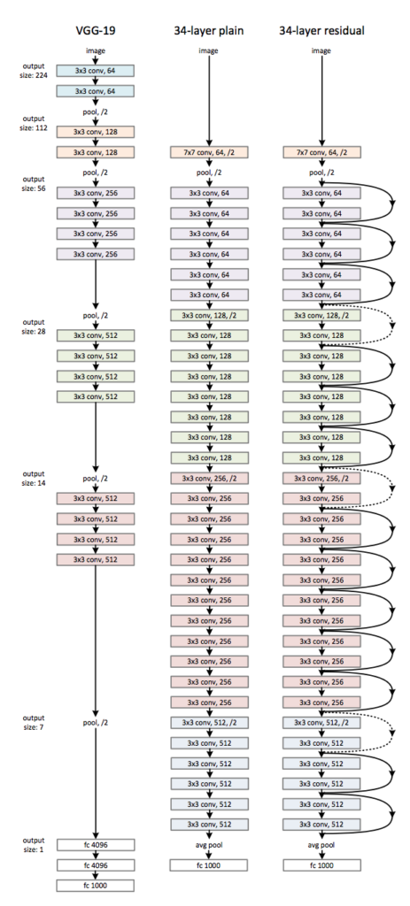
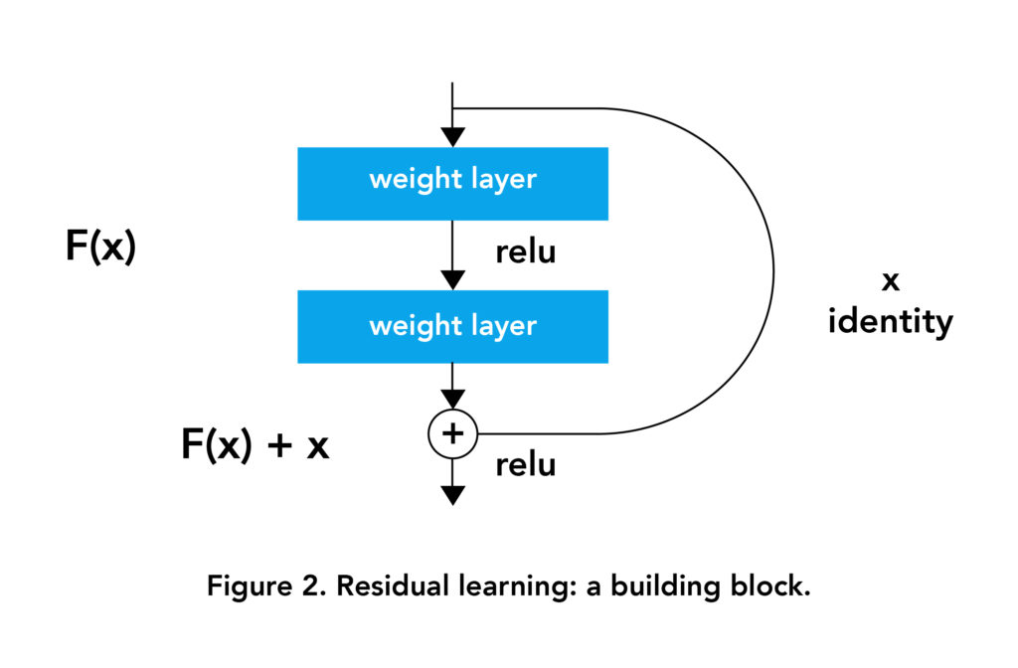
Residual Networks (1)
What are residual networks?
Residual networks are a type of artificial neural networks (ANN) that stacks residual blocks on top of each other to form a network
Type of Convolutional Neural Network

Slide 7
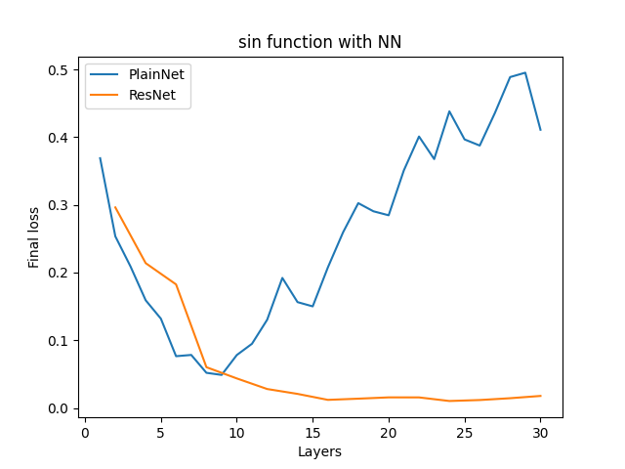
Residual Networks (2)
Why it was created?
To improve learning in general
It also solved the degradation problem
What is the degradation problem?
Increasing the depth of a network leads to a decrease in performance on both test and training data.
When the model gets deeper, it becomes more and more difficult for the layers to propagate the information from shallow layers and the information is lost.
Notes:
“Usually, when we train a Deep model using through backprop using Gradient Descent, we calculate the gradient of the output w.r.t to weight matrices and then subtract it from respective weight matrices to make its(matrix’s) values more accurate to give correct output”
But what if the gradient becomes negligible?
When the gradient becomes negligible, subtracting it from original matrix doesn’t makes any sense and hence the model stops learning. This problem is called as Vanishing Gradient Problem.

Slide 8
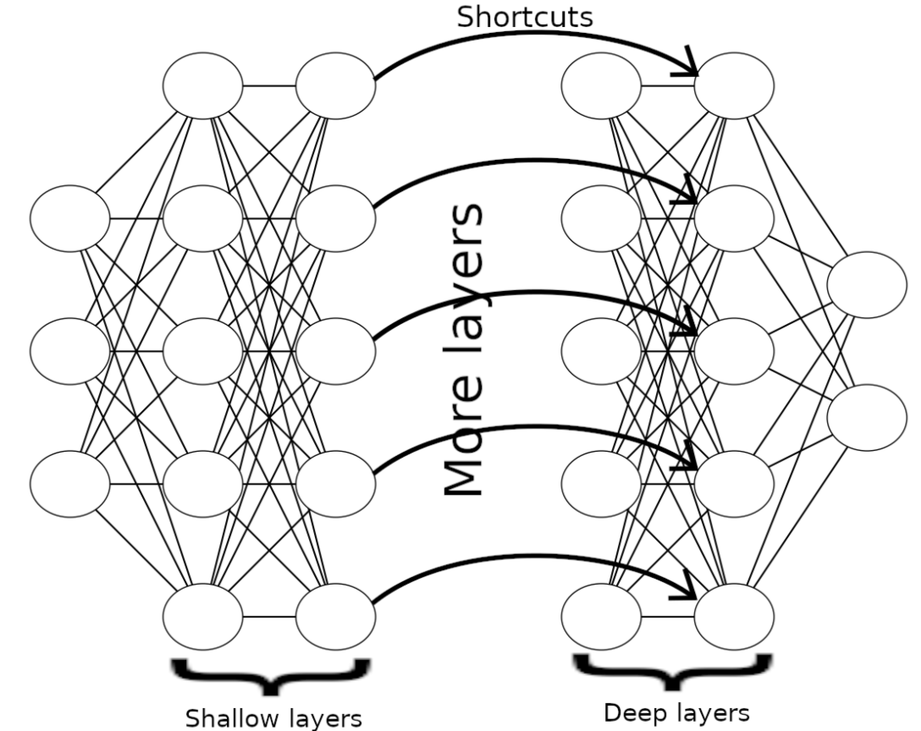
Degradation Problem
How ResNet solves the degradation problem?
Residual Networks uses “skip connections”
Connects the shallow layers and deep layers directly, so that the information is passed directly to the deep layers, like identity function.
Ensures that the higher layer will perform at least as good as the lower layer, and not worse.

Slide 9
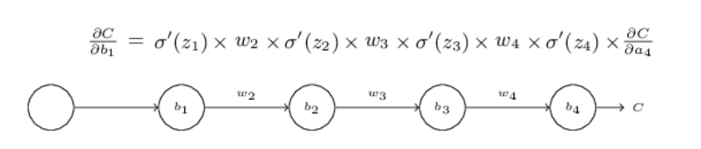
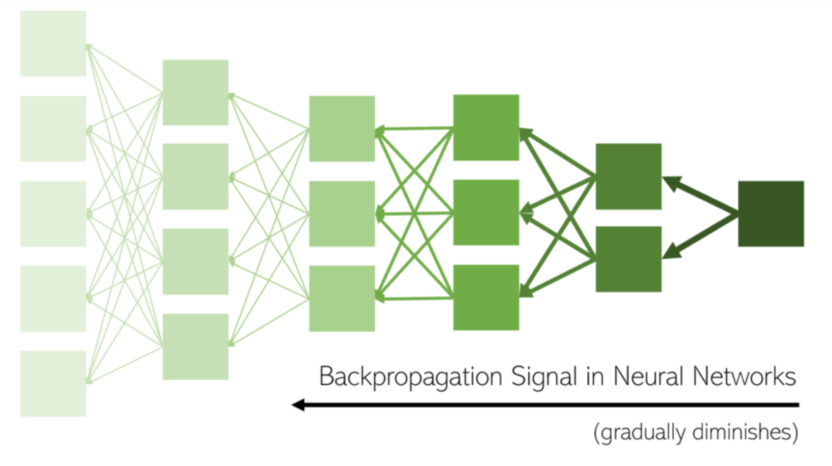
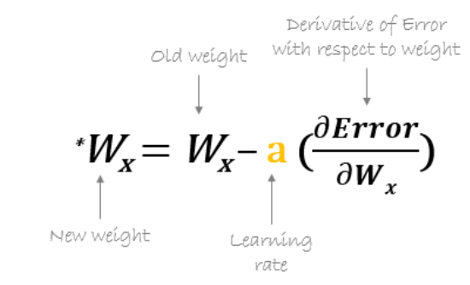
Residual Networks (3)
Why it was created?
To improve learning in general
It also solved the vanishing gradient problem
What is the vanishing gradient problem?
During back-propagation, we must keep multiplying terms with the error gradient as we go backwards.
However, if we multiply many things together that are less than one, then the resulting gradient will be infinitely small.
When the gradient becomes negligible, subtracting it from respective weight matrices will not do much and the model stops learning
Notes:
“Usually, when we train a Deep model using through backprop using Gradient Descent, we calculate the gradient of the output w.r.t to weight matrices and then subtract it from respective weight matrices to make its(matrix’s) values more accurate to give correct output”
But what if the gradient becomes negligible?
When the gradient becomes negligible, subtracting it from original matrix doesn’t makes any sense and hence the model stops learning. This problem is called as Vanishing Gradient Problem.

Slide 10
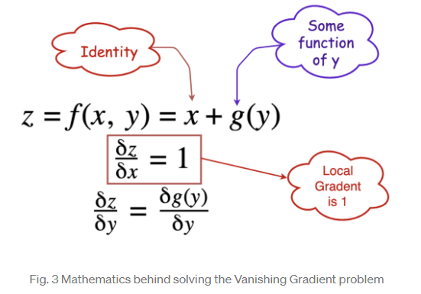
Vanishing Gradient Problem
How ResNet solves the vanishing gradient problem?
Residual Networks uses “skip connections”
The core idea is to back-propagate through the identity function, by just using a vector addition. Then the gradient would simply be multiplied by one and its value will be maintained in the earlier layers.
The identity function is used to preserve the gradient.

Slide 11
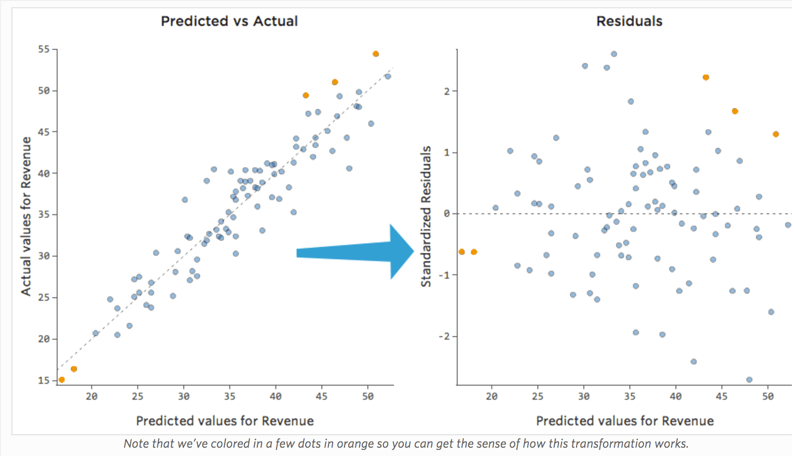
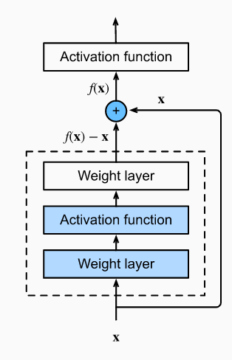
Residual Learning
Let F(x) be the function learned by the layers.
Let’s consider H(x) = F(x)+x: layers with skip connections.
Here +x term denotes the skip connection.
In H(x)=F(x)+x, the +x term will bring the original value.
Layer F(x) has to learn just the residue (f(x) – x)
What is learned in F(x) is just the residue, either positive or negative to modify x to the required value.
If the residue is 0, which means that there is no more information that it can get from the data, which is the worst case scenario, then at least, the performance will not deteriorate.
For H(x) to be identity function, the residue f(x) just has to become zero function, which when all weights are set to zero.
Then h(x) = 0+x = x, which is the required identity function.

Slide 12
Advantages of Residual Networks
Networks with large number of layers can be trained easily without increasing the training error percentage.
Reducing the effect of Vanishing Gradient Problem

Slide 13
Disadvantages of Residual Networks
Deeper network usually requires weeks for training
By adding skip level connections, you have take into account the dimensionality between the different layers.

